Slide 1
Study Buddy
By: Nathan Raras, Ayoub Ibrahim, Salma Rashed, Salma Elkadi, Andrew Noel, Andrew Le

Slide 2
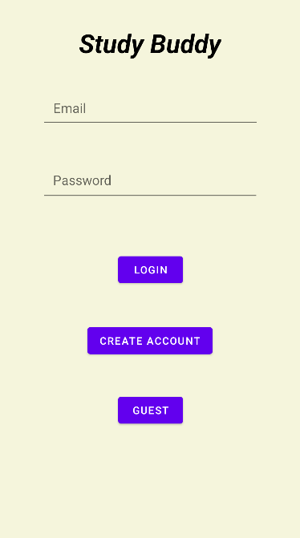
Login Page
Login will check if the info the user input is already in the database
If it is, it will continue to the main page
If not, the user is not allowed into the app and told “Authentication Error”
Create Account will save the user’s information in the firebase
Information is stored as authentication information. This means requires the user input to be correct, eg johnsmith@gmail.com
If the user’s info is already in the database, it will not allow them to create a duplicate account
User Information is stored on a firebase database
Guest will just take the user straight to the homepage without any firebase verification

Slide 3
Study Methods
The app offers different study techniques and includes a timer feature for effective time management.
StudyActivity:
It initializes variables for UI elements such as the start button, RecyclerView, and selected method TextView.
The techniques list holds predefined study techniques with their respective steps.
The myTechniques map maps techniques to their steps and durations.
In the onCreate method, it sets the layout, configures the RecyclerView with the TechniqueAdapter, and handles click events on the start button and navigation items.

Slide 4
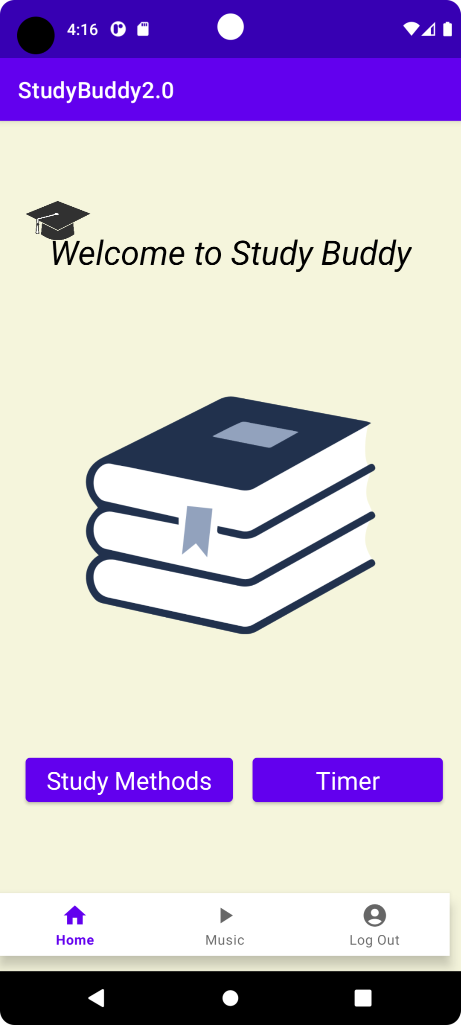
Bottom Navigation Bar
This navigation bar is present on all pages! (Study Methods, Timer, Home, Music)
Home
Functionality: Allow user to go back to the Home page and access other parts of the app
Music
Functionality: Access to Android MediaPlayer API to allow users to play different Mp3 files while studying
Log out
Functionality: To allow the user to log back out to the login page and access the application as a different user/guest

Slide 5
Android MediaPlayer API
Allows user to control playback of a selection of raw audio files
User is able to start, pause, and stop the audio
Audio continues to play when navigating through the application
Issues:
Github has a maximum file size but works with any mp3 file size locally

Slide 6
Thank You!!

